Slide 1
Llama CRM
Overview and User Guide
Reality Labs & AI Partnerships
v2025.04.01
Notes:
PARTNER HOME VERSION: https://docs.google.com/presentation/d/1l_jsvIe92B2-PvfU07YW2Ch3qcZcfLOqBYBD4DKsa0A/edit#slide=id.g30b23988c99_0_1299

Slide 2
01
02
03
Context
What is built for the Llama MVP
Feedback & Feature Requests
Reality Labs & AI Partnerships |

Slide 3






01 CONTEXT
What have we built?
We have built a Customer Relationship Management (CRM) solution in Salesforce to help RL & AI Partnerships teams manage relationships and interactions with partners with LlamaX being the first MVP use case
Reality Labs & AI Partnerships |

Slide 4



More Partners
More Complexity
More Alignment
01 CONTEXT
Why do we need a CRM for RL & AI Partnerships (and LlamaX in particular)?
Since taking on AI, RLP’s portfolio has grown from managing dozens of partners to hundreds
With the emergence of AI, there are now multiple touch points with a single partner across multiple teams
An increase in various gSheet trackers has made it difficult to align around a single-source-of-truth
Reality Labs & AI Partnerships |

Slide 5

01 CONTEXT
LlamaX GTM teams currently use an ever-evolving Google Sheet to track and manage partner information.
Segmentation
Funnel stage
Partner Name
Job title, role, etc.
Pipeline
Contacts
Case studies, marketing, etc.
Documents (e.g., NDA)
Phone, email, etc.
Decision maker, influencer, etc.
Project plan, details, etc
Status
Notes, risks, etc.

Slide 6



01 CONTEXT
Unfortunately, these spreadsheets are not standardized or connected to other Meta teams.
That means our Meta teams work with the same partners without knowing it, which creates poor experiences for us and our external partners.

Slide 7



Manage partner set
Track partner interactions
Monitor partner deals & initiatives
02 USE CASES IN MVP
Managed Partner Set (MPS)
Meetings and interactions
Track progress
Portfolio Maintenance
Tag SPM/BD to partner
Update existing partners
Offboard inactive partners
Tag internal stakeholders
Upload external contacts
Historical Record
Add and edit key partner meetings and interactions
Historical Record
Maintain updates and status of ongoing work
Partner contacts
Historical timeline
Add collateral
Historical Record
Link-out to gDocs and add reference types (e.g., case studies, use cases)
Easily see timeline of all partner engagement
Reality Labs & AI Partnerships |

Slide 8
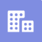


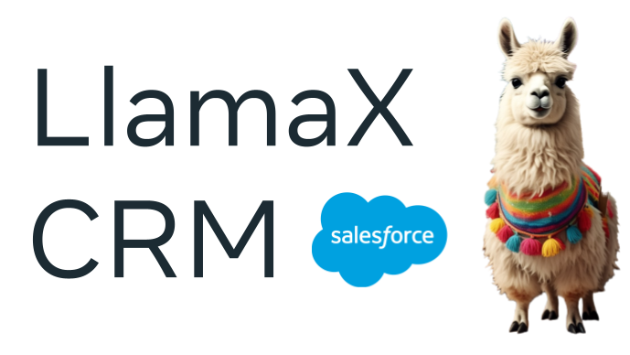

02 USE CASES IN MVP
Key terms you’ll see in Salesforce (SF)
Account
Opportunity
Implementation
Can be either a Channel Partner, Partner, or Customer
An engagement with a Partner, tracked through various stages
A technical deployment of the opportunity
Either a Customer or a Channel Partner
An engagement with the Customer
PR process starting from POC to production
Translations, recommendation systems
TBD, at Scope POC stage

Slide 9
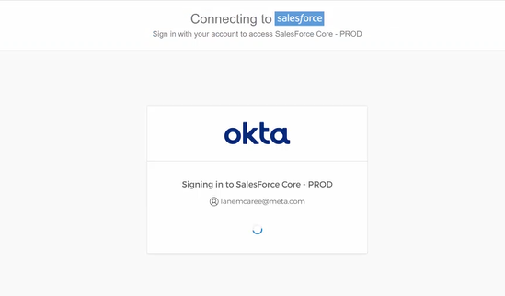
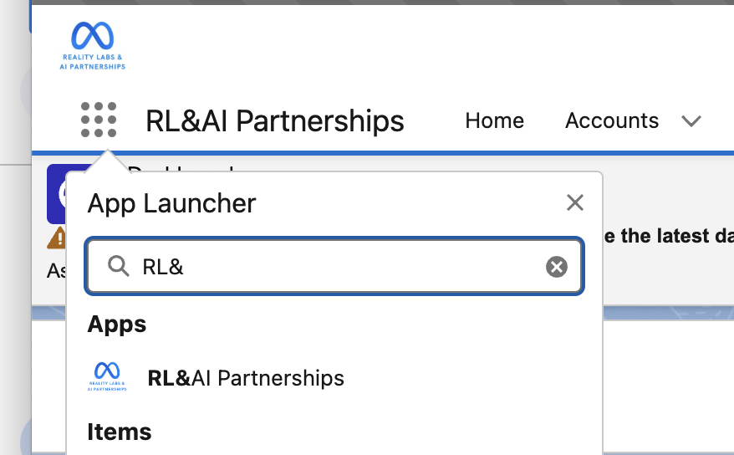
02 GETTING STARTED
Salesforce login
Takeaway | Salesforce RL & AI Partnerships Salesforce “app” can be accessed through https://fb.my.salesforce.com/ and uses our SSO
1
Click here to login.
2
You will be automatically logged in using Single Sign On (SSO) with your enterprise credentials.
3
From the drop-down app menu at the upper-right corner, select “App Launcher.”
4
Search for and click the tile “RL&AI Partnerships”
5
You’ll be taken to the Home Page where there is a dashboard. Now you’re in!

Slide 10


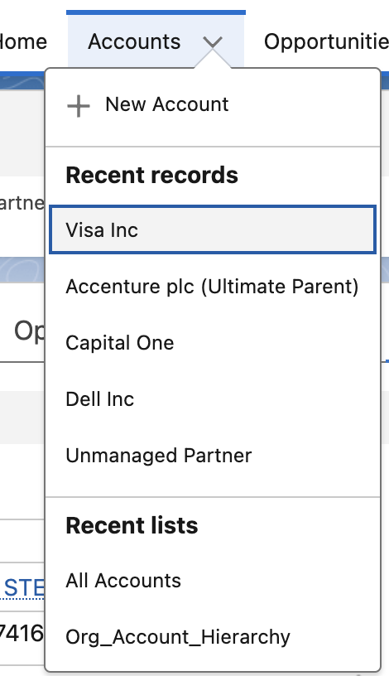

02 GETTING STARTED
Navigation overview
Takeaway | Google-like search to find Accounts and Opportunities (although list view is better); rest of nav is self explanatory
TIPS:
Global Search: A built-in search engine in Salesforce, similar to Google. It allows you to find accounts, opportunities, and more with fuzzy matches
Use "List View" instead of Global Search to distinguish between multiple records with the same name (see next slide)
Fundamentals: UX and Navigation
Accounts and Account Teams
Click on a header (e.g., Opportunities) to view a list of related records.
How to use these icons
Add the record, report, etc. to your Favorites list
This will light up when you have a notification
App Launcher: you can also use to search for an Object (e.g., Implementation)
Opportunities and Implementations
Click the carrot next to a header to view recently accessed records
Reality Labs & AI Partnerships |

Slide 11
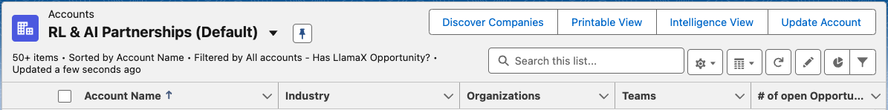
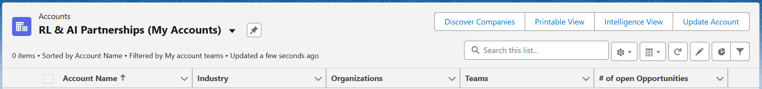

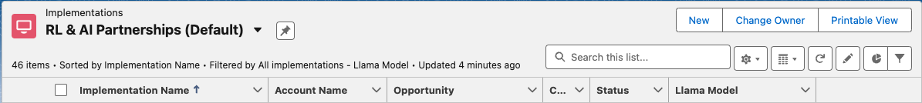

02 GETTING STARTED
Our favorite ‘List Views’ to consider pinning
Takeaway | Select from a pre-created list of views: either what is important to YOU vs relevant to all Metamates working on Llama
ACCOUNT
RL & AI Partnerships (Default) → List of all Accounts with at least 1 Llama Opportunity
Fundamentals: UX and Navigation
RL & AI Partnerships (My Accounts) → List of all Accounts where you are a member of the Account Team
TIPS:
Customize Your View
Pin one List view per section (e.g., Account) for easy access.
Save additional views by:
Clicking the star icon in the top right corner
Viewing the List View, which adds it to Recently Viewed
Default List Views
The 3 default list views are the same for all users, except for Private Opportunities, which are only visible to Opportunity Team members, Executives, or StratOps
Help! SF “forgot” the list view I pinned earlier
This happens after clearing the cache from your browser. Simply re-pin the list again
OPPORTUNITY
List of all Llama Opportunities (looks same to all)
List of all Opportunities where you are a member of the Opportunity Team
IMPLEMENTATION
List of all Llama implementations (looks same to all)
List of all Implementations where you are either the listed Partner Engineer or Partner Manager
Reality Labs & AI Partnerships |

Slide 12
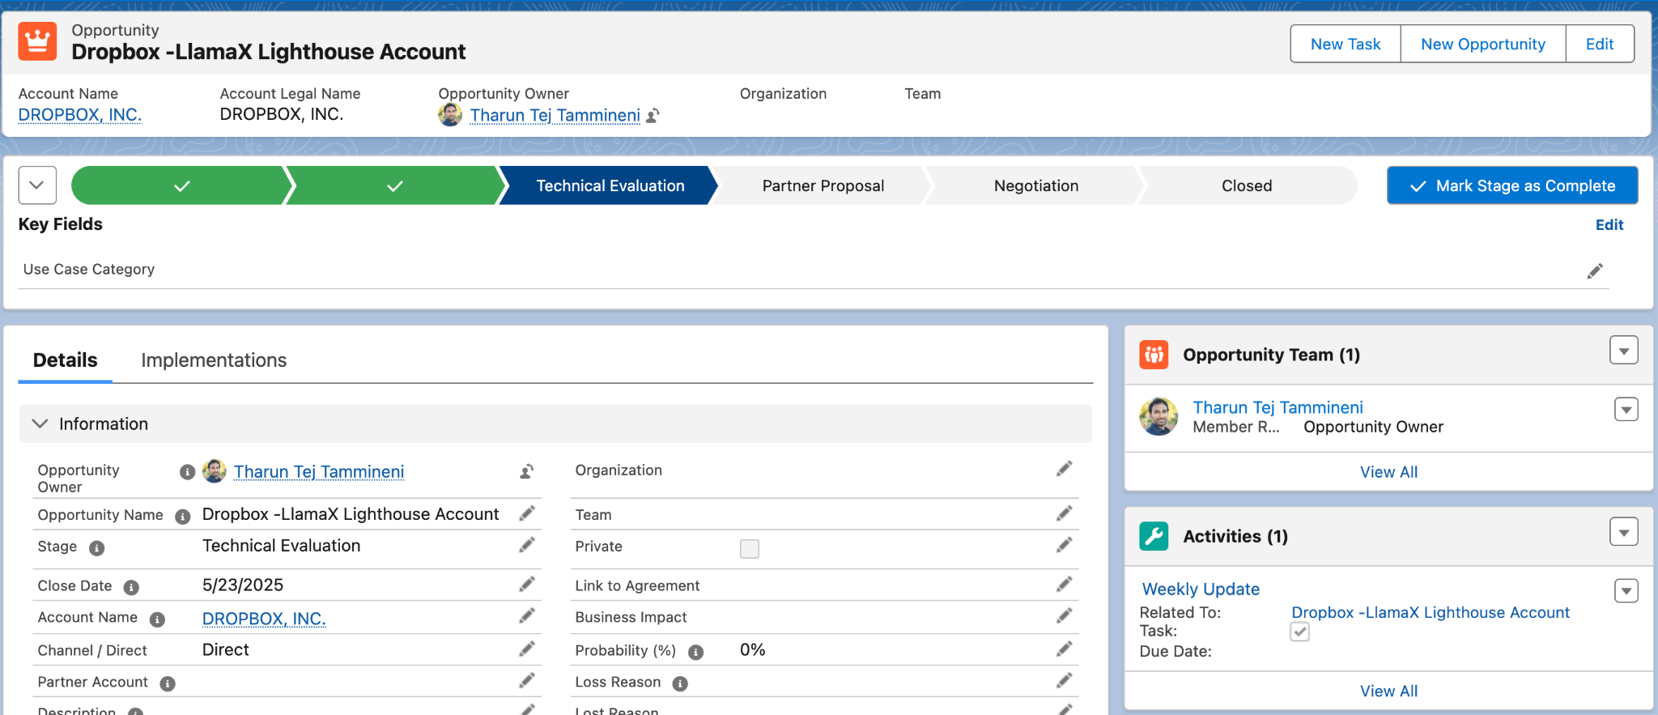
02 USE CASES
Tasks - use for gDoc links, weekly updates, and more
Takeaway | “Task” can be tied to an Account, Opportunity, or to an Implementation
Tasks (or "Activities") in Salesforce are used to log specific actions related to Accounts, Contacts, Opportunities, and other records for operational tracking.
Fundamentals: UX and Navigation
Click “New Task” to log a task. You can also find this button in the same location on the Account and Implementation pages
Accounts and Account Teams
Opportunities and Implementations
Tasks that have been logged show up on the side panel as an “Activity”
TIPS:
Associate Tasks Correctly: Create Tasks from the most relevant location, e.g.,
Opportunity: specific use cases or updates on an ongoing deal
Account: general account plans or meeting notes that should be visible to all
Note: Tasks created in one location won't appear on other pages.
Reality Labs & AI Partnerships |

Slide 13
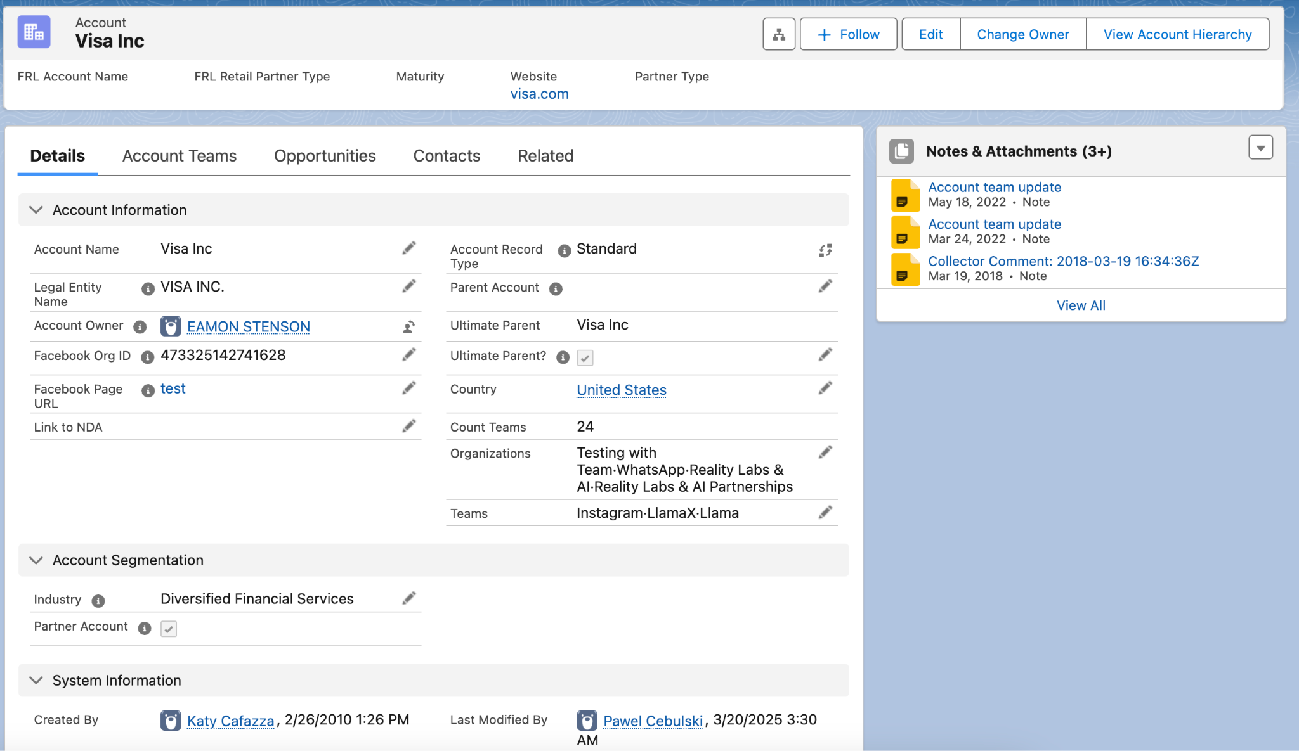
02 USE CASES
Accounts
Takeaway | View shared, Meta-wide partner (customer) data here; most fields are read-only, except for adding items like NDAs
View Meta-wide key partner information and related details by clicking on the tabs.
Fundamentals:
UX and Navigation
Accounts and Account Teams
Opportunities and Implementations
TIPS:
You will not be able to edit Account Information directly, so request support here
Reality Labs & AI Partnerships |

Slide 14
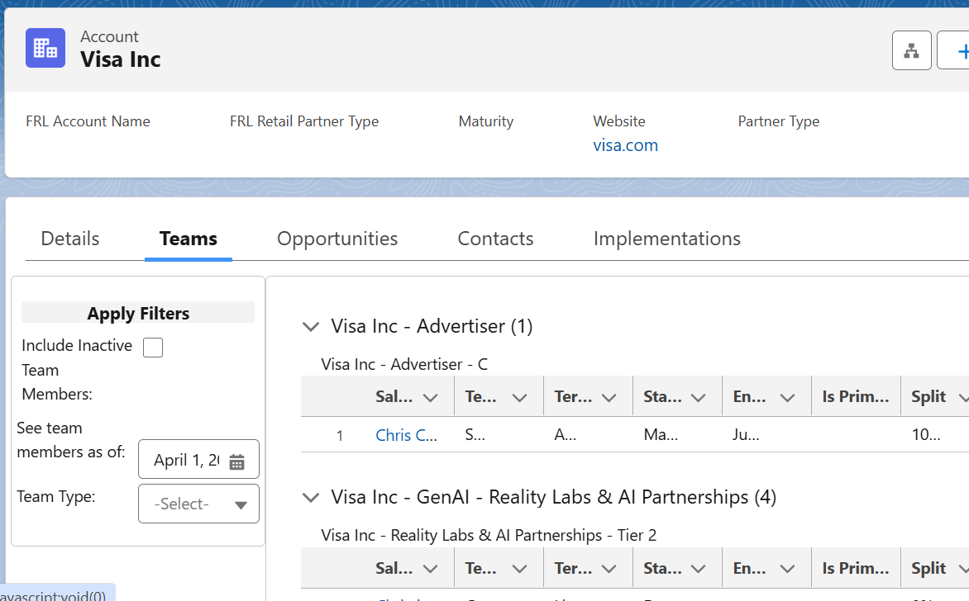
02 USE CASES
Account teams
Takeaway | Account Teams (aka Teams) help you identify relevant XFN Metamates to connect with for partner support and insights
View Meta teams assigned to the partner
TIPS:
Add to Account Team in Salesforce: Use the feedback form to request adding yourself to a new team
Fundamentals:
UX and Navigation
Accounts and Account Teams
TIPS:
Relevant teams you will see in Salesforce:
Global Accounts Team
Global Business Group (GBG)
Business Marketing Group (BMG)
Agency Team
App Monetization (App Mon)
Client Business Group (CBG)
Workplace Team
Reality Labs Sales (RL Sales)
Global Partnerships and Content (GP&C)
Business and Marketing Partnerships (BMP)
Gaming Partnerships Team
Mobile Partnerships Team
Opportunities and Implementations
Reality Labs & AI Partnerships |

Slide 15
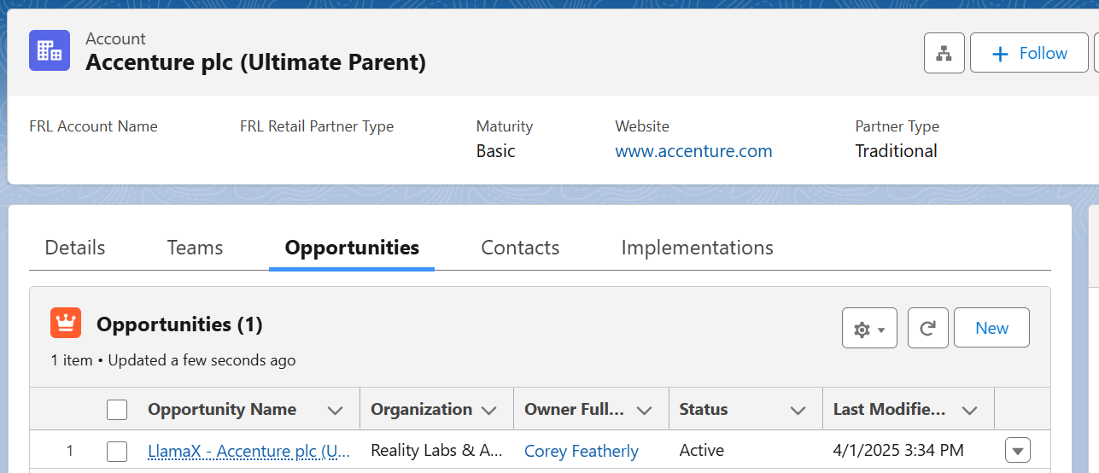
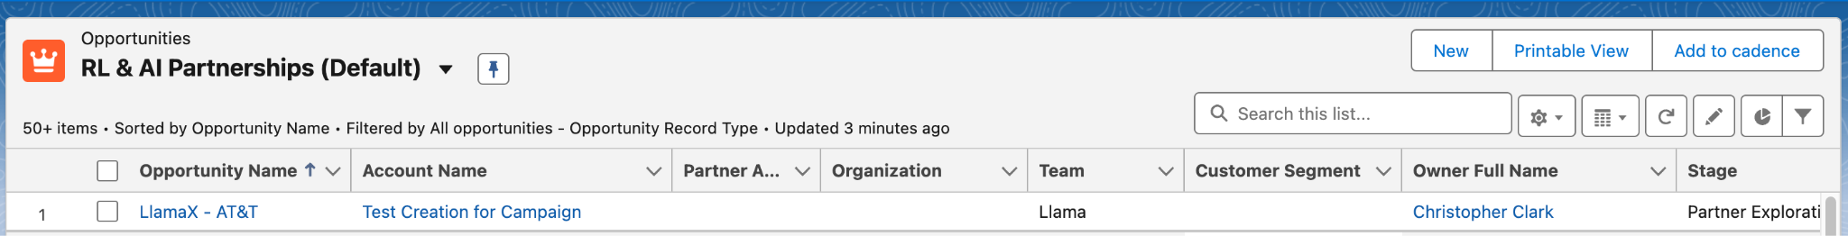
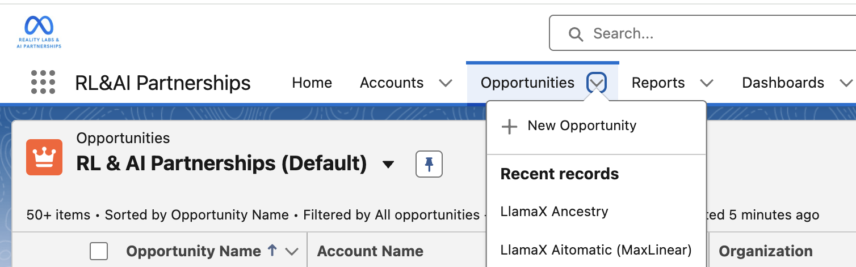
02 USE CASES
How to create an Opportunity (1 of 2)
Takeaway | Create opportunities from a customer account, with one opportunity per use case
Option 1: Go to Customer Account > Opportunities tab > Click "New"
PREFERRED METHOD
Fundamentals:
UX and Navigation
Accounts and Account Teams
Option 2: Click “New” from Opportunity list view
Opportunities and Implementations
Option 3: Click the Opportunities carrot in the top navigation bar (will require you enter the Account)
TIPS:
Create Opportunity based on Customer account, not Channel Partner
Track each use case as a separate opportunity if they have different decision makers, implementations, or timelines
Reality Labs & AI Partnerships |
Notes:
NOTE: You can create an Opportunity from an existing Opportunity but suggest not using that flow

Slide 16
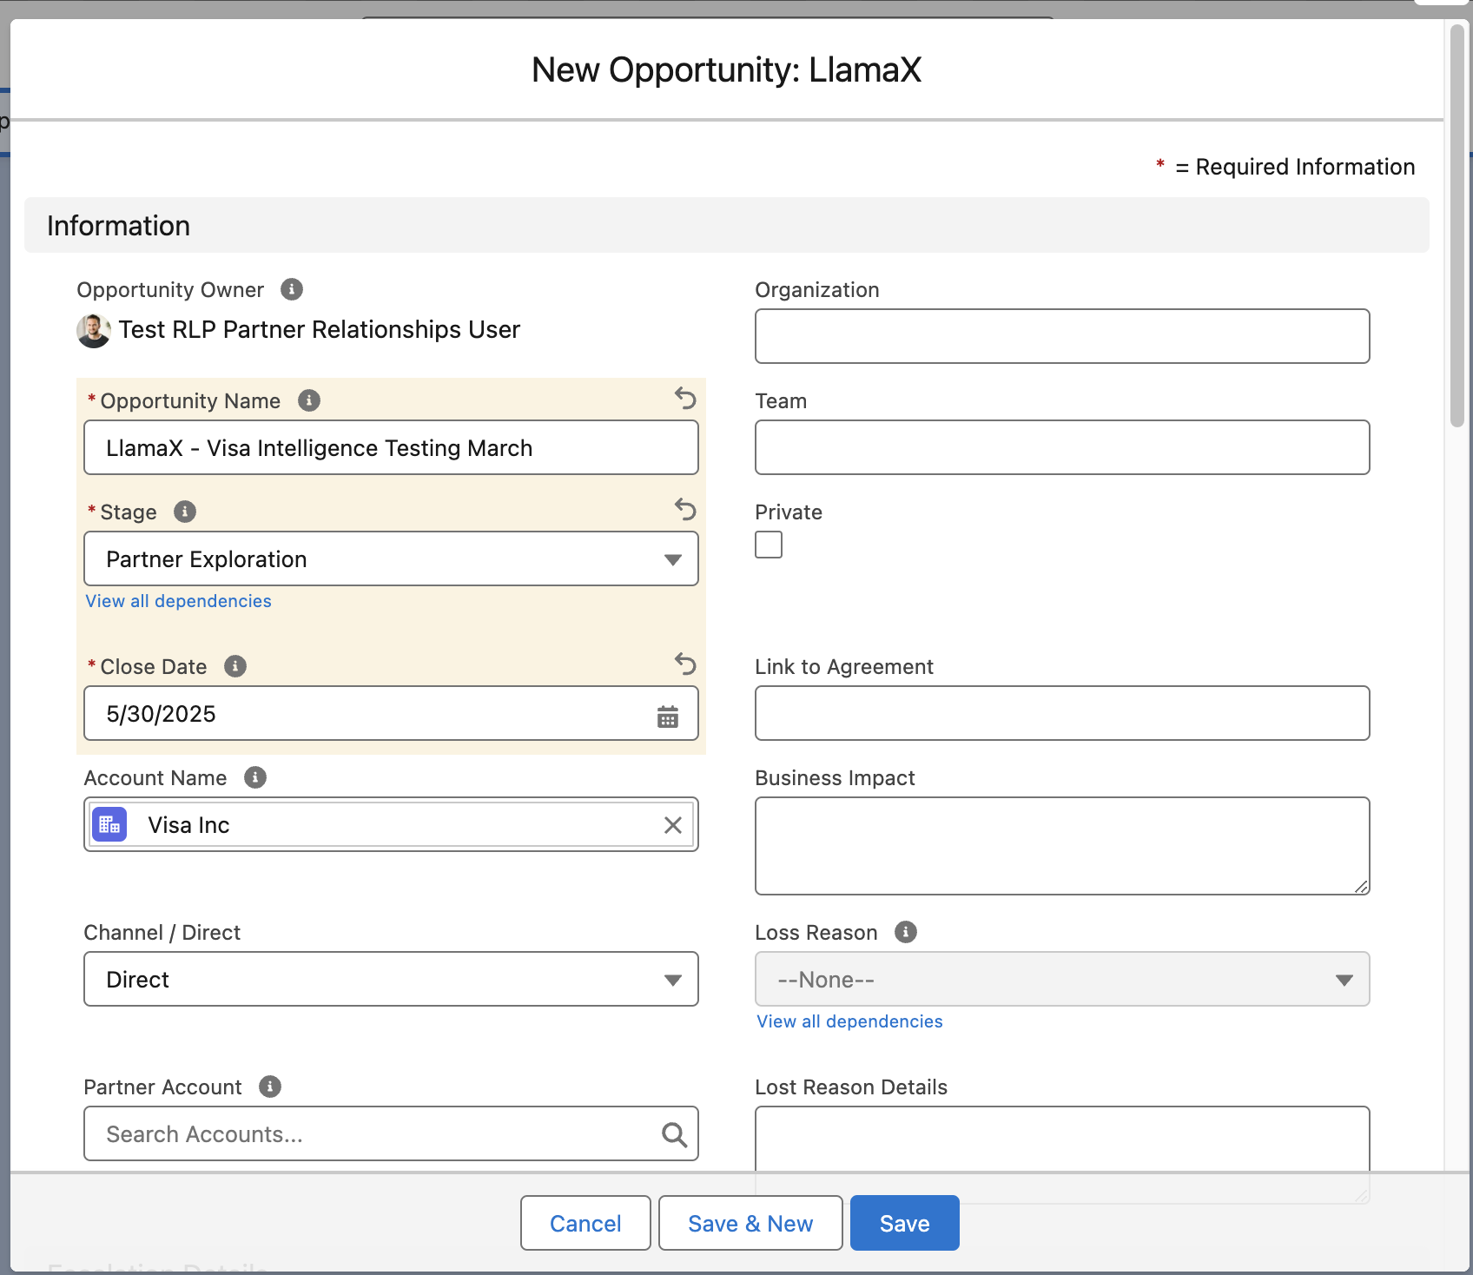
02 USE CASES
How to create an Opportunity (2 of 2)
Takeaway | To record an opportunity, fill in three key fields
Do not edit these fields. “Organization” and “Team” will auto-populate after you click Save
Fundamentals:
UX and Navigation
There are three required fields record an opportunity
Accounts and Account Teams
TIPS:
Name Opportunities Clearly: Use "LlamaX - Partner Name Simple Description" for easy identification
Set Initial Stage: Start with "Partner Exploration" unless it's a lead, then use “Internal Identification”
Estimate Close Date: Set to when you expect kick off production, and update as needed
Deleting an Opportunity: Submit a feedback form
Opportunities and Implementations
Reality Labs & AI Partnerships |

Slide 17
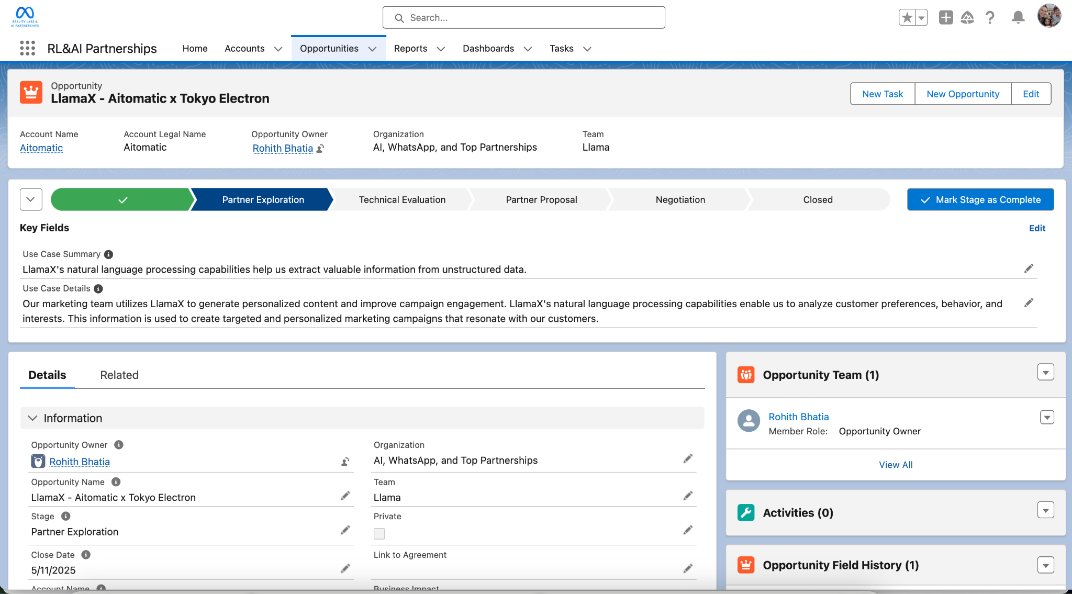
02 USE CASES
Managing an Opportunity
Takeaway | Manage opportunities by updating stages, tasks, and related info.
Tasks
Add weekly updates, meeting notes, reminders
Opportunity Progression Click the next chevron or "Mark Stage as Complete" to progress through stages.
Opportunity Details
Edit fields by either clicking the pencil icon next to each field OR the "Edit" button at the top right.
Related Info
View team members, notes, links, and change history.
Reality Labs & AI Partnerships |

Slide 18
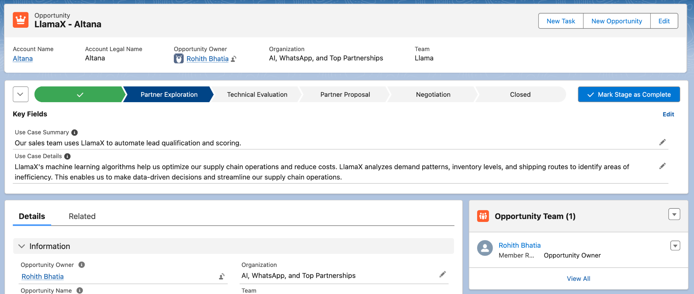
02 USE CASES
Opportunity Teams (1 of 3)
Takeaway | Opportunity Teams grant edit access, ease reporting, and give credit to contributors.
Why Opportunity Teams matter
Grants Edit Access: Allows them to make changes.
Eases Reporting: Helps individuals track their opportunities.
Gives Credit: Recognizes their contributions (future feature).
Fundamentals:
UX and Navigation
Accounts and Account Teams
Opportunities and Implementations
TIPS:
The Opportunity Team is a subset of the Account Team, and may include the same individuals.
The creator is automatically listed as the Opportunity Owner.
Who Should be on an Opportunity Team?
Internal team members working on the opportunity, such as BD, SPM, CSM, and PE, should be included. Additionally, external partners like channel partners' BD, marketing teams for potential case studies, and relevant XFN teams that originated the opportunity should also be part of the Opportunity Team.
Opportunity team members are not automatically added to an Opportunity. You must manually add them to the opportunity (detailed next)
Reality Labs & AI Partnerships |

Slide 19
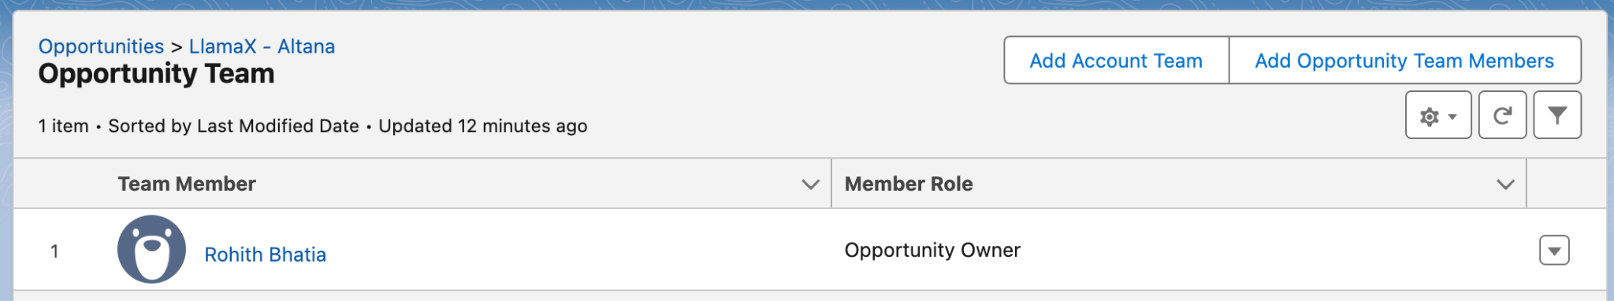
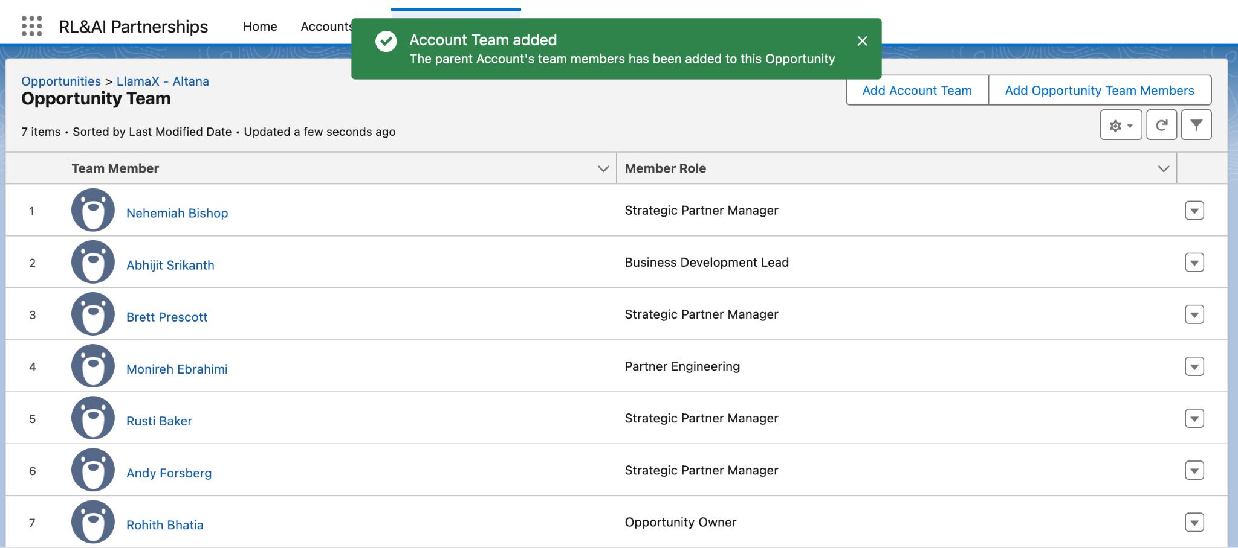
02 USE CASES
Opportunity Teams (2 of 3)
Takeaway | Two ways to add Opportunity Team members, automatic is quickest to add core Account Team members
Option 1: Automatic - add entire Account Team with one click (relevant if entire Account Team is engaged in the Opportunity)
PREFERRED METHOD
Fundamentals:
UX and Navigation
Option 2: Add individually - manually add Metamates to the Opportunity (best when XFN need to be added)
Accounts and Account Teams
PREFERRED METHOD
Opportunities and Implementations
Option 1: Automatic
From this view, you can delete individuals that are not relevant to this specific engagement (click on carrot on right side)
Delete button for that Metamate
Reality Labs & AI Partnerships |

Slide 20
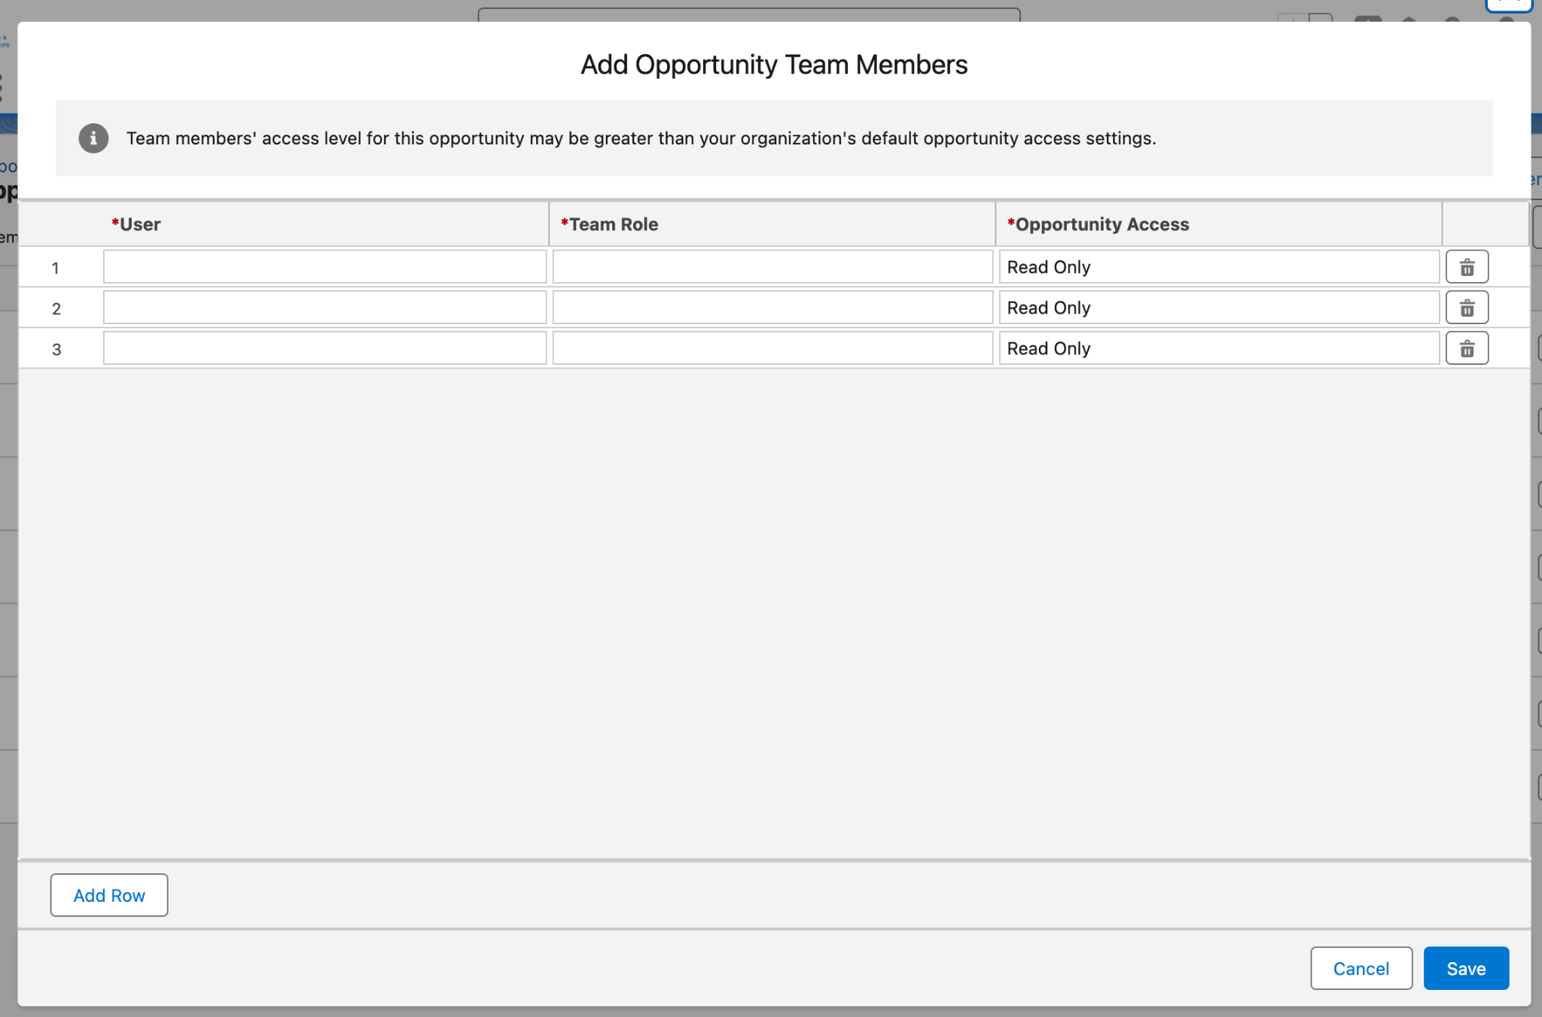
02 USE CASES
Opportunity Teams (3 of 3)
Takeaway | Use this option to add team members not directly assigned to the partner such as XFN teams.
Option 2: Add individually - this process is best for XFN that may not be tied to Account Team
Fundamentals:
UX and Navigation
Accounts and Account Teams
(1) SEARCH for the name of the person (it will start to autofill)
(2) SELECT the team role (Customer Success Manager, Business Development, etc.)
(3) SELECT the access level - read only or read/write
Opportunities and Implementations
TIPS:
All XFN will need to be added through this method to edit Opportunity details
Reality Labs & AI Partnerships |

Slide 21
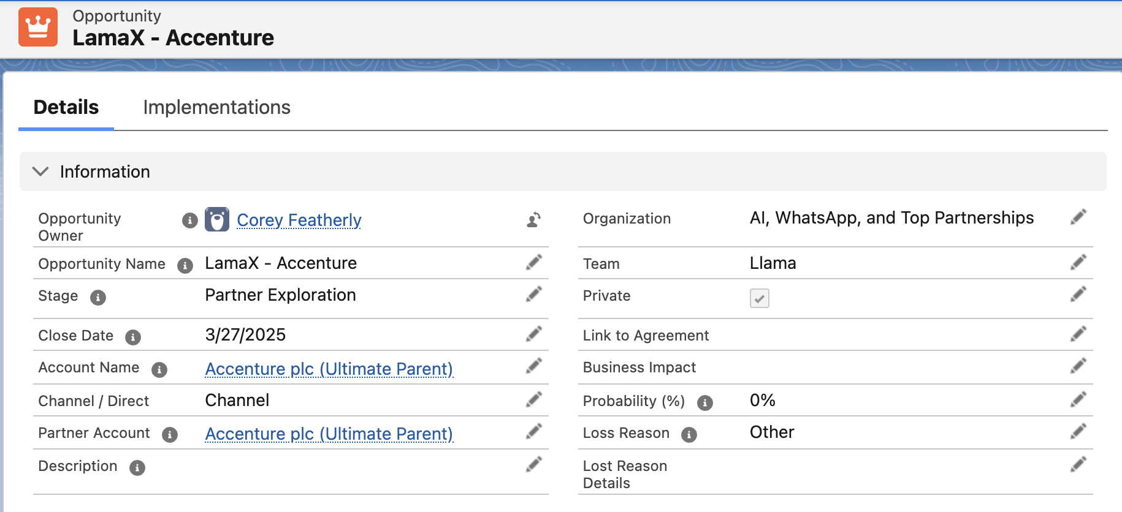
02 USE CASES
Private Opportunities (uncommon)
Takeaway | Mark an opportunity as "Private" if it's a highly confidential project that only authorized individuals should know about.
Fundamentals:
UX and Navigation
In the Details section on the Opportunity page, click on the checkbox next to “Private”. Then click Save.
Accounts and Account Teams
What happens when you mark an Opportunity as "Private"?
Marking an Opportunity as "Private" controls who can view its details. Here's how it works:
Default (non-private) opportunities: Any Metamate with Llama CRM access can see the details, but only Opportunity Team members can edit.
Private opportunities: Only these individuals can view the details
Opportunity Owner
Opportunity Team members
Executives (mostly VP level)
StratOps and SF administrators
Opportunities and Implementations
TIPS:
When evaluating who has access to see the Opportunity, always consider using Opportunity Teams functionality first.
Reality Labs & AI Partnerships |

Slide 22
02 USE CASES
Stages in Opportunities
Takeaway | Each stage aligns with the LlamaX Customer engagement process and is mapped to the now-deprecated Pipeline Sheet.
AKA: Awareness. Internal exploration and prioritization of a partner/customer/channel partner (simplified as partner in these descriptions); also can be considered a Lead or a potential Initiative; at this stage, there has likely been no discussions with the partner.
Easy setup tasks to personalize your UX
AKA: Consideration. Exploring the opportunity with the partner through early conversations, without any official commitments from either side.
Accounts and Account Teams
AKA: Proof of Concept. Evaluating the technical feasibility of the opportunity, including creating a Proof of Concept to test the solution.
Opportunities and Implementations
[SKIPPED FOR LLAMAX] Creating a proposal and quote for the partner, outlining the scope of work, timeline, and costs in a detailed breakdown.
Conducting negotiations with the partner to reach a mutually beneficial agreement on terms and conditions.
AKA: Production. Closing the opportunity as won or lost, moving forward with implementation if won, or documenting reasons for loss if lost; at this stage, PE will create an Implementation record to track production progress
Reality Labs & AI Partnerships |

Slide 23
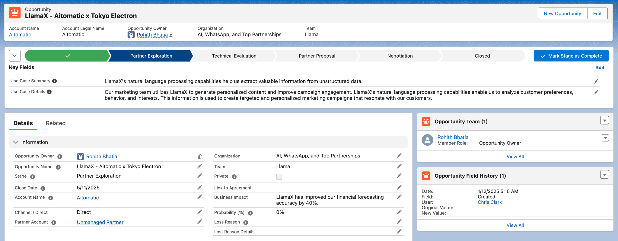
02 USE CASES
Opportunity - Partner Exploration
Takeaway | Complete the "Use Case Summary" and "Use Case Details" fields to progress to the Technical Evaluation stage.
AKA: Consideration. Exploring the opportunity with the partner through early conversations, without any official commitments from either side.
Fundamentals:
UX and Navigation
Accounts and Account Teams
Opportunities and Implementations
TIPS:
Complete "Use Case Summary" (255 character limit so keep this section a short summary) and "Use Case Details" to progress.
Edit these fields in either the "Key Fields" or "LlamaX Details" sections.
Reality Labs & AI Partnerships |

Slide 24
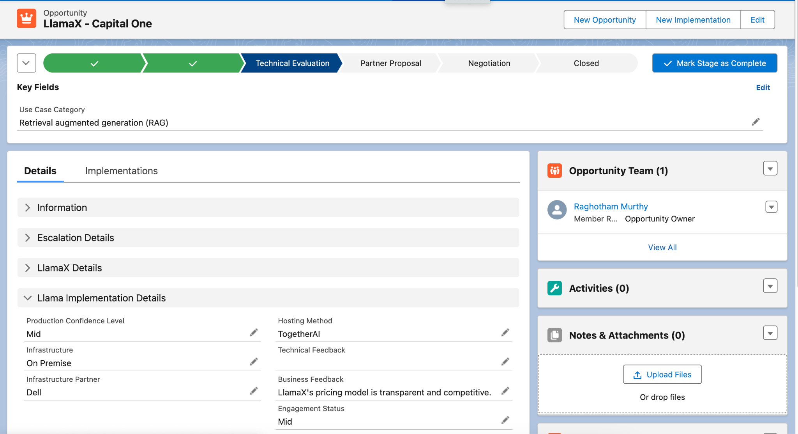
02 USE CASES
Opportunity - Technical Evaluation
Takeaway | The PE/SA assigned to the Opportunity should fill in the "Llama Implementation Details" section.
AKA: Proof of Concept. Evaluating the technical feasibility of the opportunity, including creating a Proof of Concept to test the solution.
Fundamentals:
UX and Navigation
Accounts and Account Teams
Opportunities and Implementations
TIPS:
“Use Case Category” is the required field to move to the next stage
To Exit, go straight to “Negotiation” Phase (click on that stage at the top)
Reality Labs & AI Partnerships |

Slide 25
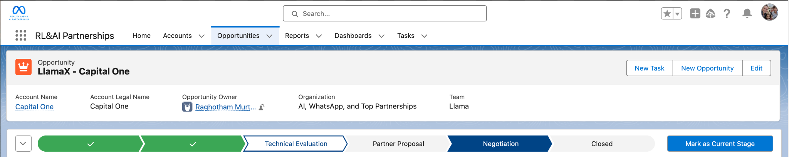
02 USE CASES
Opportunity - Partner Proposal (Skip for now)
Takeaway | For LlamaX Opportunities, skip the "Partner Proposal" stage and move to the "Negotiation" stage.
[SKIPPED FOR LLAMAX] Creating a proposal and quote for the partner, outlining the scope of work, timeline, and costs in a detailed breakdown.
Fundamentals:
UX and Navigation
The "Partner Proposal" stage is not required for MVP, but will be used by other RL & AI Partnerships teams that need to go through a proposal process before negotiating a contract
Accounts and Account Teams
Opportunities and Implementations
Reality Labs & AI Partnerships |

Slide 26
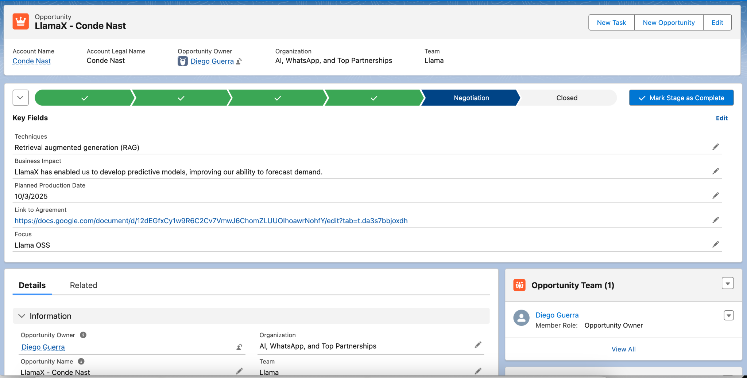
02 USE CASES
Opportunity - Negotiation
Takeaway | The "Negotiation" stage is the final step before “Closed”, where all details are finalized for a production deployment.
Conducting negotiations with the partner to reach a mutually beneficial agreement on terms and conditions.
Fundamentals:
UX and Navigation
Accounts and Account Teams
Opportunities and Implementations
TIPS:
To progress from this stage to “Closed/Won”, add Business Impact, Planned Production Date, link to any agreements, and the focus (products)
Reality Labs & AI Partnerships |

Slide 27
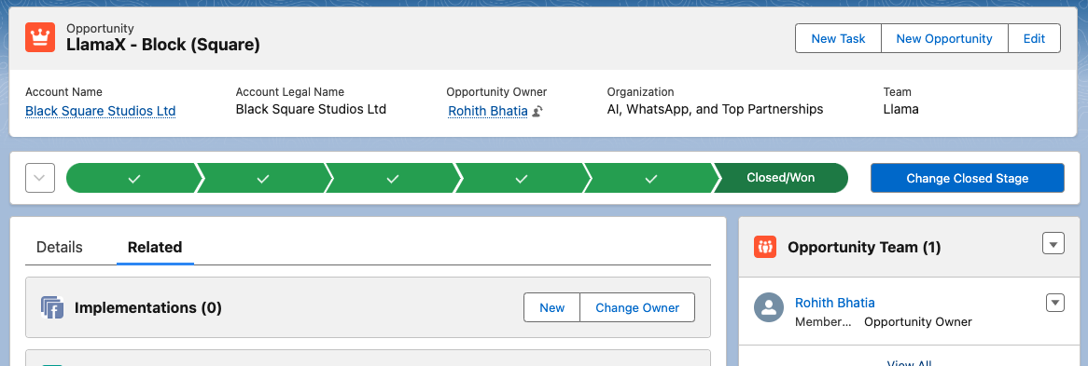
02 USE CASES
Opportunity - Closed/Won
Takeaway | To close an opportunity, click "Close" and create an Implementation to start the “Production”
Conducting negotiations with the partner to reach a mutually beneficial agreement on terms and conditions.
Fundamentals:
UX and Navigation
Accounts and Account Teams
Opportunities and Implementations
After "Closed/Won," the next task is for PE/SA to kick off an Implementation by going to the "Related" tab, clicking "New," and filling in the fields in the pop-up box.
TIPS:
PE/SA can create an Implementation at any time, but it must be done by the time the opportunity is closed.
Reality Labs & AI Partnerships |

Slide 28
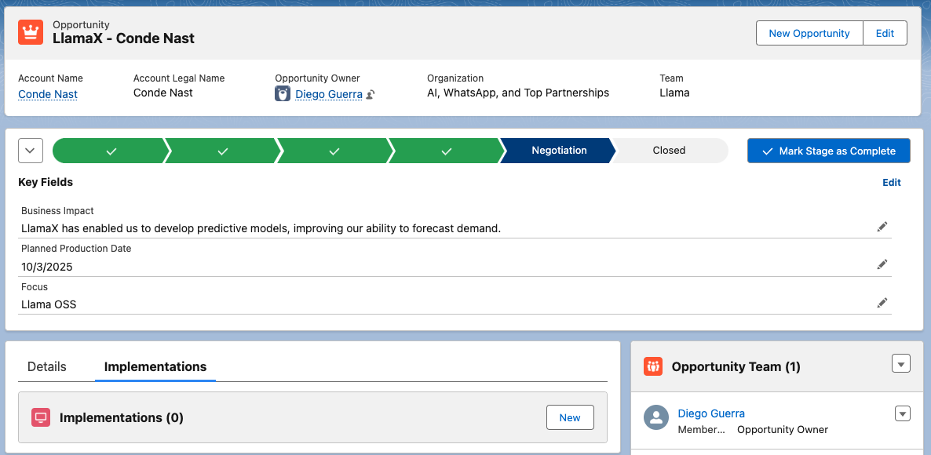
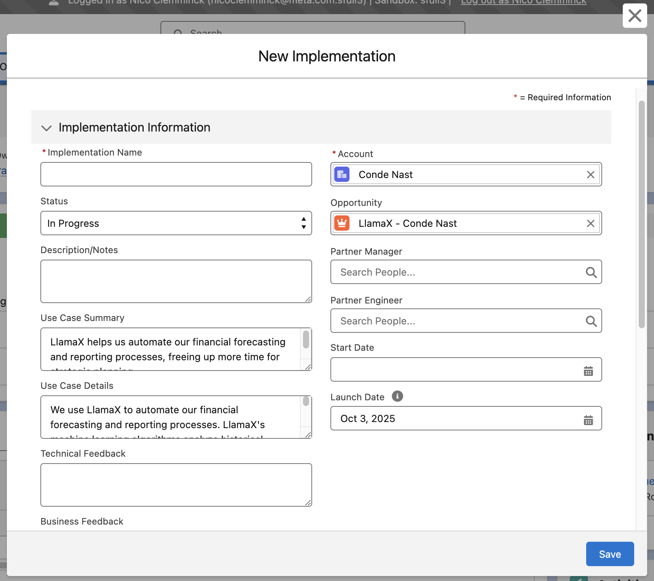
02 USE CASES
How to create an Implementation
Takeaway | Create implementations from the relevant Opportunity before moving it to “Closed/Won”
Step 1: Go to Opportunity > Implementations tab > Click "New"
Step 2: Confirm and fill in the information on the “New” screen, then click Save
Fundamentals:
UX and Navigation
Accounts and Account Teams
Opportunities and Implementations
TIPS:
Create Implementation: PE can create an Implementation at any Opportunity stage, but ensure it's done before "Closed/Won" or "Closed/Lost".
Pre-Populate Information: Fill out as much Opportunity information as possible first, as key details will auto-fill into the Implementation record.
Delete Implementation: Use the feedback form
Reality Labs & AI Partnerships |

Slide 29


Please use the link below to provide feedback, to ask for support, and more
03 FEEDBACK & FEATURE REQUESTS
http://fburl.com/LlamaCRMfeedback
Stephanie Chen
Nico Clemminck
Brought to you by RL & AI Partnerships StratOps

Slide 30
WHAT WE EXPECT FROM YOU
Use the Salesforce CRM to do your day-to-day work
Provide feedback on the workflow as LlamaX workflows continue to develop
Do not spin up net-new trackers

